Slide 1

Risk Management in Mojaloop Product Engineering
Mojaloop Foundation Engineering Update
November 2024

Slide 2
Our context…
Mojaloop software is intended to form the backbone of nation scale inclusive instant payments schemes.
These schemes are important pieces of regulated national financial infrastructure which facilitate the life critical daily activities of a great number of people, such as purchasing food and clean drinking water, or paying utility bills.
Our adopters, their regulators and the people transacting through Mojaloop schemes demand and deserve an extremely high level of quality, security, reliability and resilience from our products.

Slide 3
Risk?
A risk is…
“The possibility of something bad happening”
[Cambridge English Dictionary]
The things we might consider “bad” depend on our particular perspective as Mojaloop stakeholders.
(our adopters, their regulators and the people transacting through Mojaloop schemes)

Slide 4
Why do the Mojaloop Foundation care about risks?
Risk management plays a critical role in ensuring the safety, reliability and ultimately the success of Mojaloop deployments.
If we don’t spend enough time thinking about what might go wrong, and actively trying to prevent bad outcomes, we are not being diligent and responsible.
In most regulated domains, especially financials and national infrastructure, strong, formal risk management is a “table stakes” requirement.

Slide 5
Areas where our stakeholders face risk
E.g.
Security
Compliance and Regulation
Operations
Finance
Business Continuity
Reputation
Scalability and Performance
Project Management and Development

Slide 6
Security Risks
Examples:
Data Breach: Unauthorized access to sensitive financial data, like customer information or transaction details, could lead to severe financial losses and reputational damage.
Malware and Ransomware: Malware infections or ransomware attacks can halt operations, compromise data integrity, or even lead to ransom payments.
Insider Threats: Malicious or negligent actions by employees can expose the organization to data leaks, unauthorized data manipulation, or fraud.
Weak Authentication and Access Control: Inadequate access controls can lead to unauthorized actions and data exposure, especially critical in systems handling financial data.

Slide 7
Compliance and Regulatory Risks
Examples:
Data Protection Regulations: Failure to comply with regulations such as GDPR, or local financial laws could result in fines, legal action, or suspension of operations.
AML and KYC Violations: Anti-Money Laundering (AML) and Know Your Customer (KYC) regulations are critical in finance; non-compliance could result in severe penalties.
Financial Reporting Requirements: Misreporting or failure to meet reporting standards can lead to scrutiny by regulators and possibly fines or corrective mandates.

Slide 8
Operational Risks
Examples:
System Downtime: Downtime in payment processing or data handling systems can disrupt services, severely affecting customers lives. This may erode confidence in a scheme.
Dependency Risks: Relying on third-party vendors (e.g., for cloud services or APIs) may introduce risk if these vendors experience downtime or security breaches.

Slide 9
Financial Risks
Examples:
Accounting Accuracy Risk: Discrepancies or inconsistencies in accounting records may lead to costly disputes, large financial losses, reputational damage, regulatory sanctions and even loss of operating licenses.
Fraud and Financial Crime: Fraudulent transactions or other financial crimes can lead to direct financial losses and legal implications.

Slide 10
Business Continuity Risks
Examples:
Disaster Recovery and Backups: Inadequate disaster recovery capability can lead to data loss or extended downtime in the case of natural disasters, power outages, or other major incidents.
Lack of Redundancy: Not having redundancy in systems risks prolonged service disruptions if critical components go down.

Slide 11
Reputational Risks
Examples:
Customer Trust: Security incidents, compliance violations, or even minor service disruptions can erode customer confidence, affecting retention and new customer acquisition.
Brand Damage: Association with fraudulent activities or mishandling customer data can lead to long-term brand damage, impacting partnerships and market position.

Slide 12
Scalability and Performance Risks
Examples:
Capacity Constraints: If the software can’t scale to handle growing transaction volumes, this could lead to slower processing, transaction delays, and dissatisfied customers.
Latency Issues: High latency can impact real-time transactions; when replacing cash milliseconds matter.

Slide 13
Project Management and Development Risks
Examples:
Scope Creep: Uncontrolled changes or additions to project requirements can increase complexity and lead to missed deadlines or over-budget situations.
Innovation Risk: Relying on new technologies or unproven methodologies can lead to project delays, compatibility issues, or failure to meet business objectives.

Slide 14
Best practice
If we don’t spend enough time thinking about what might go wrong, and actively trying to prevent bad outcomes, we are not being diligent and responsible.
…therefore…
We should dedicate time to thinking about what might go wrong and trying to prevent bad outcomes.

Slide 15
Best practice
OK, but how?
Formal risk management frameworks for engineering projects have existed for some time, they are based on learnings from a large number of projects.
There are several relevant standards we can look to for guidance e.g. ISO/IEC 31000, ISO/IEC 27005, NIST SP 800-30, ISO/IEC 9001, PMBOK, ISO/IEC 12207, COBIT, OCTAVE, ISTQB etc…

Slide 16
Best practice
These standards and frameworks have common themes which can be condensed into a general framework:
Project leaders should:
Identify and record areas of risk and specific risks within those areas.
Think about, quantify and record the potential damage of bad outcomes.
Identify, record and enact mitigations to minimise both the likelihood of a bad outcome occurring and the amount of damage that may be caused.
Continuously repeat this process to identify new risks, re-assess existing risks and evaluate the effectiveness of existing mitigations.

Slide 17
Best practice
Risk management is not just an engineering concern.
Risks exist across every layer and level of our domain.
Risk management needs to be embedded in all of our processes.
Product thinking and feature design:
In delivering our features, what risks are we creating for our adopters and their stakeholders? How can we minimize them?”, “What features should we have to minimize risks?”
Architectural thinking:
Choosing compromises that minimize risk.
Engineering processes:
Employing mitigations to ensure we deliver correct, low risk feature implementations.

Slide 18
The status quo…
The Mojaloop community, through the Mojaloop Foundation already implements a number of risk mitigations and controls:
The Mojaloop Invariants.
Principles we look to for guidance when choosing compromises.
Design and code review requirements.
Ensuring correct, low risk feature implementations.
Standards for component and tool choice.
Evaluating risks associated with 3rd party components.
Cybersecurity architecture.
Specific processes and controls to minimize cybersec risks.

Slide 19
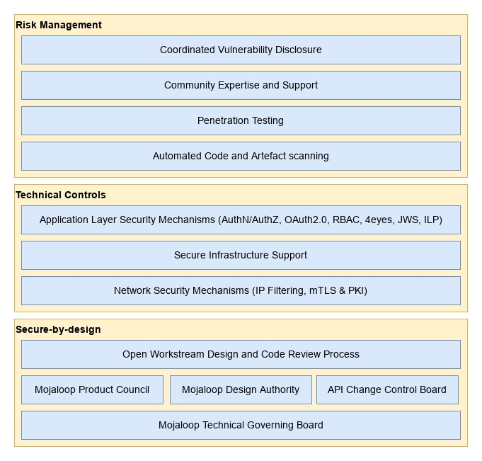

Continuous improvement…
We have re-examined our approach to risk management across the entire product engineering landscape to identify areas for improvement…

Slide 20
Upcoming Changes
Community process improvements:
Maintaining a central product engineering risk register:
Community owned, facilitated by MLF.
Workstreams to contribute and review regularly.
Improved mitigations for some already managed areas of risk:
Formal processes for traceability from feature identification, through adoption by the Product Council, integration with the Roadmap, scrutiny by the Design Authority, code development and integration with a Mojaloop release.
Better support for workstreams from the Design Authority:
Clearer written definitions of change types and risk levels.
Clearer written guidance on mandatory design and code review.
DA given new responsibilities to operate design and code review process to support workstreams.
Improved written guidance for contributors across the board:
Workstream operations and working practices.
Design review.
Code review.

Slide 21
Upcoming Changes
Watch out for upcoming discussions on risk management in the Product Council, Community Council and Design Authority.
Documentation updates currently being reviewed. Expect publication in the coming weeks.

Slide 22
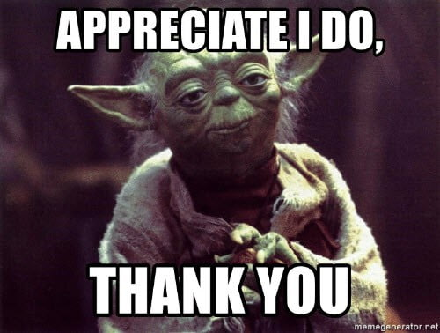
Thank you for listening
Email: james.bush@mojaloop.io
Mojaloop Slack: @James Bush

